Slide 1
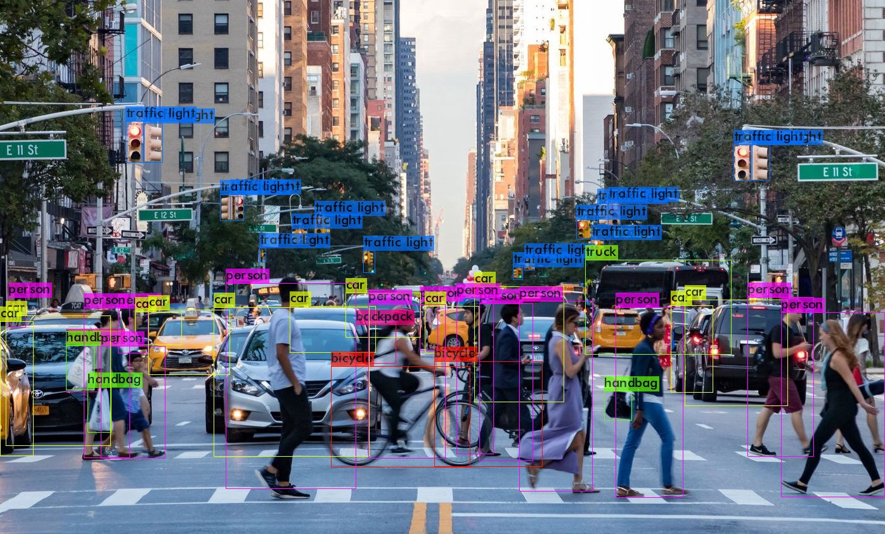
Object Detection using Yolov4 Tiny & DeepSort

Slide 2
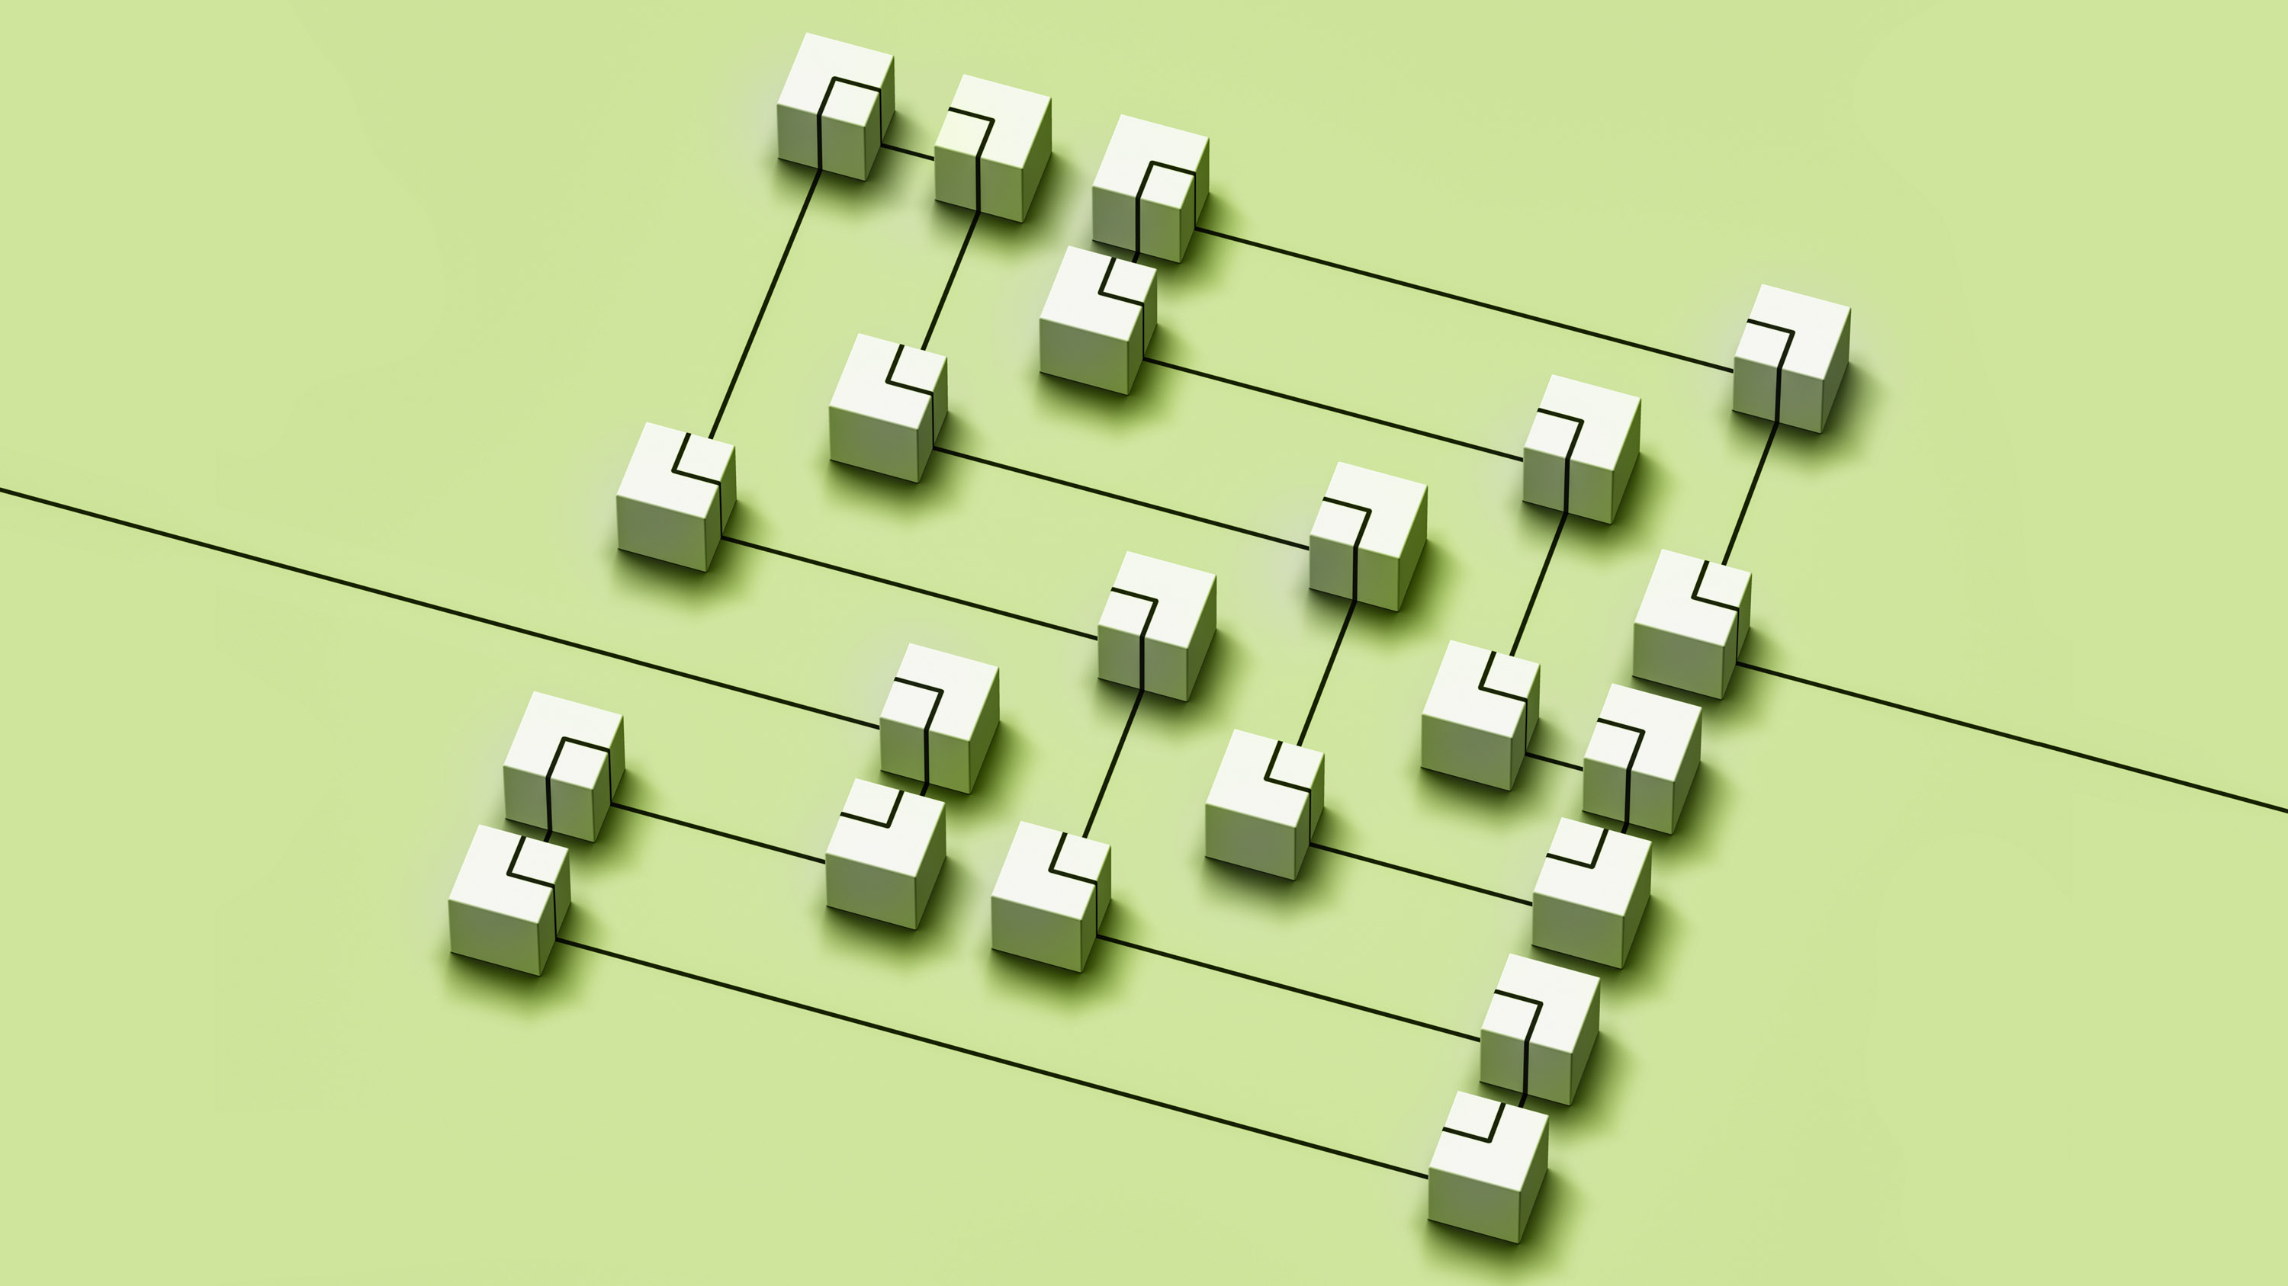
Algorithm

Slide 3
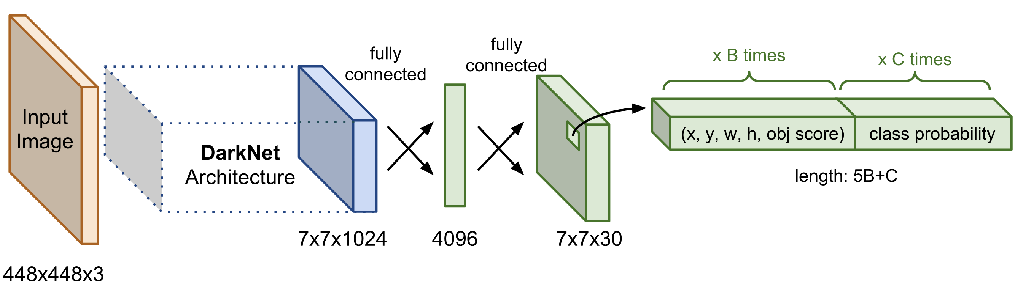
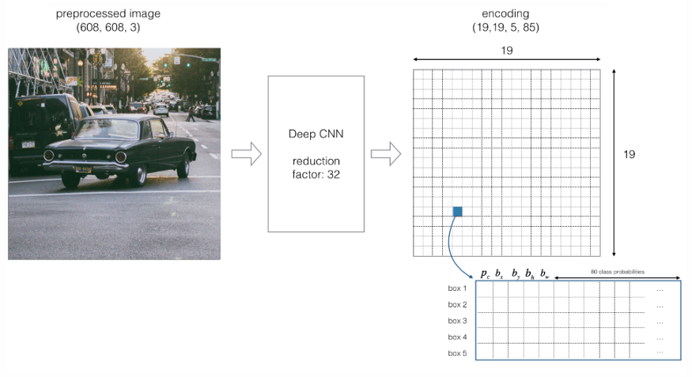
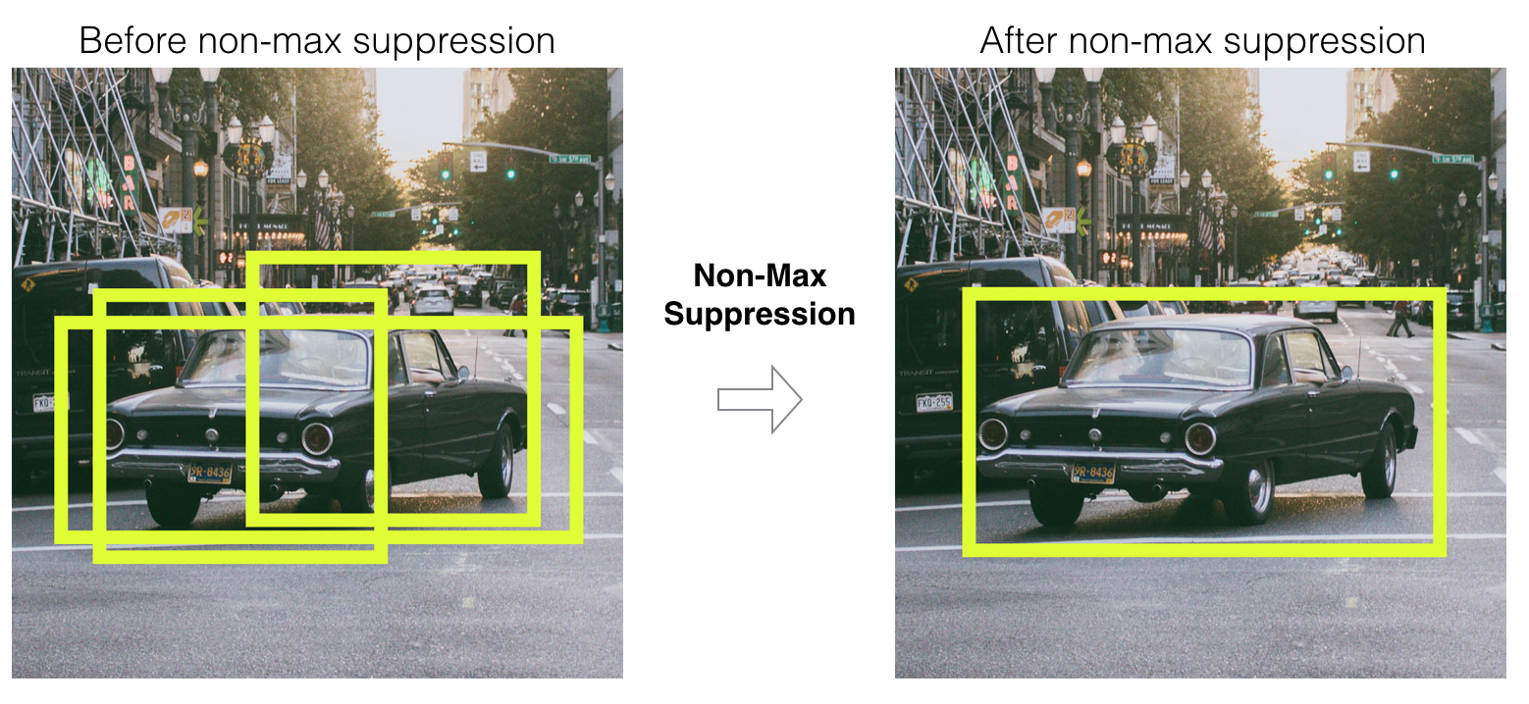
Yolo Implementation:
Input – Image/Frame of a Video.
Split image into cells (say 19 x 19).
Each cell is to predict K bounding boxes.
Predicted values into output vector containing – pc, bx, by, bh, bw, c1, c2, c3 ….. Cn.
After applying IOU (Intersection over Union) & Non-max suppression, low probability bounding boxes are removed.
Output – Image/Frame with bounding box over the required objects with their classes.
Algorithm Details
Traditional Yolo
Input – Video Frames (416 x416)

Slide 4
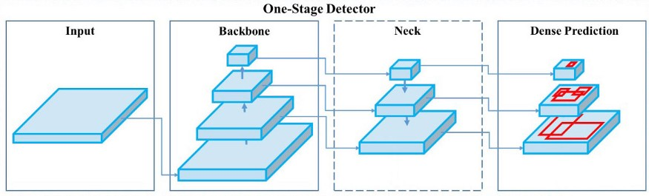
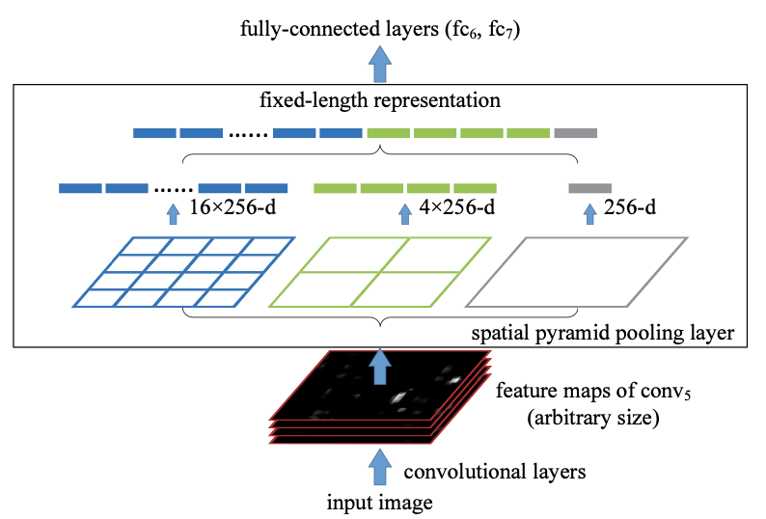
Yolo V4 is implemented in 4 stages:
Backbone: For feature extraction of input image. Yolo Tiny (9 layers) or CSPDarknet-53 (53 layers).
Neck: SAM (Spatial Attention Module), PAN (Path Aggregation Neck), SPP (Spatial Pyramid Pooling) techniques are used to concatenate the feature maps from Backbone with information
Head: Uses same processes (such as non-max suppression) in Yolo V3 to detect object using bounding boxes and confidence scores.
Yolov4 Tiny – (29 pre-trained convolution layers) 4x faster than Yolov4 (137 layers).
Algorithm Details
Changes in Yolov4 compared to Traditional

Slide 5
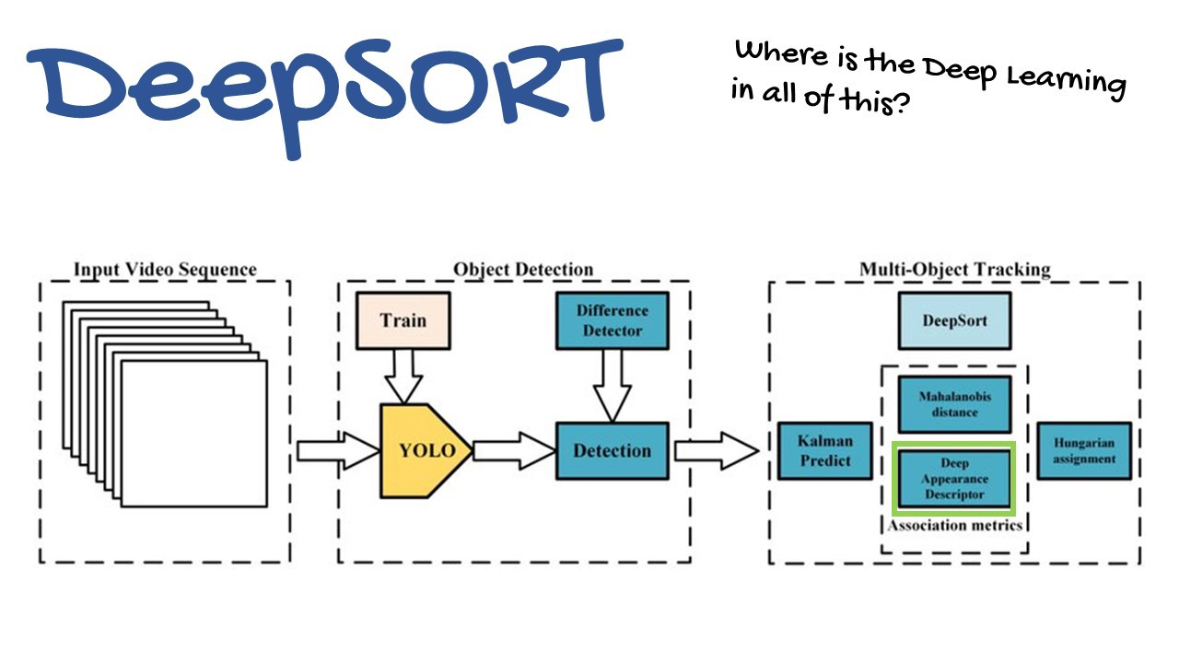
Algorithm Details
Deep SORT (Simple Online and Real time Tracking)
Deep SORT:
Simple, fast and accurate tracking algorithm for detectors
Object is tracked using Kalman Filter (i.e., assuming a constant velocity model and gaussian distribution for the object, predicting its position) & SORT algorithm.
SORT include Detection, Estimation, Association, & Track Identity creation and destruction.
Use appearance descriptor for improved tracking & assign ID to each object.
Output – Bounded and Tracked Objects with IDs in the Video Frames

Slide 6
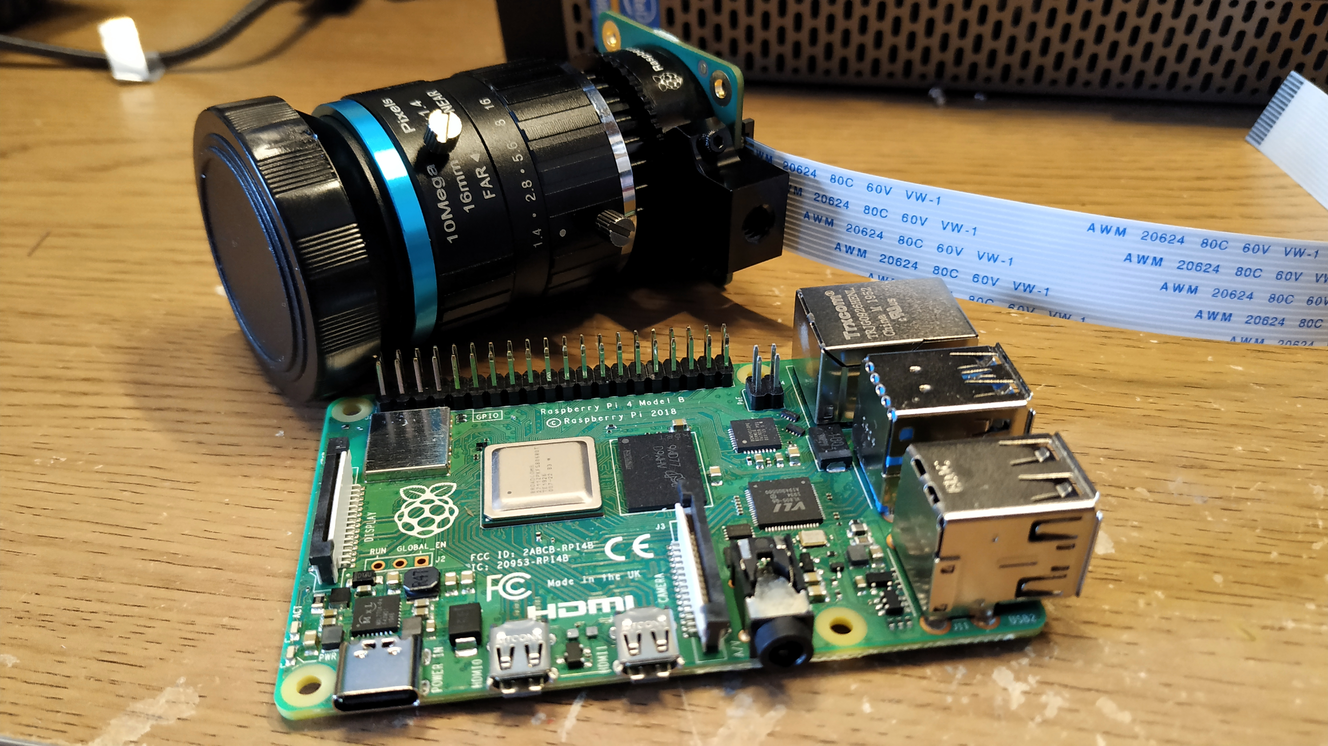
Input Data Source

Slide 7
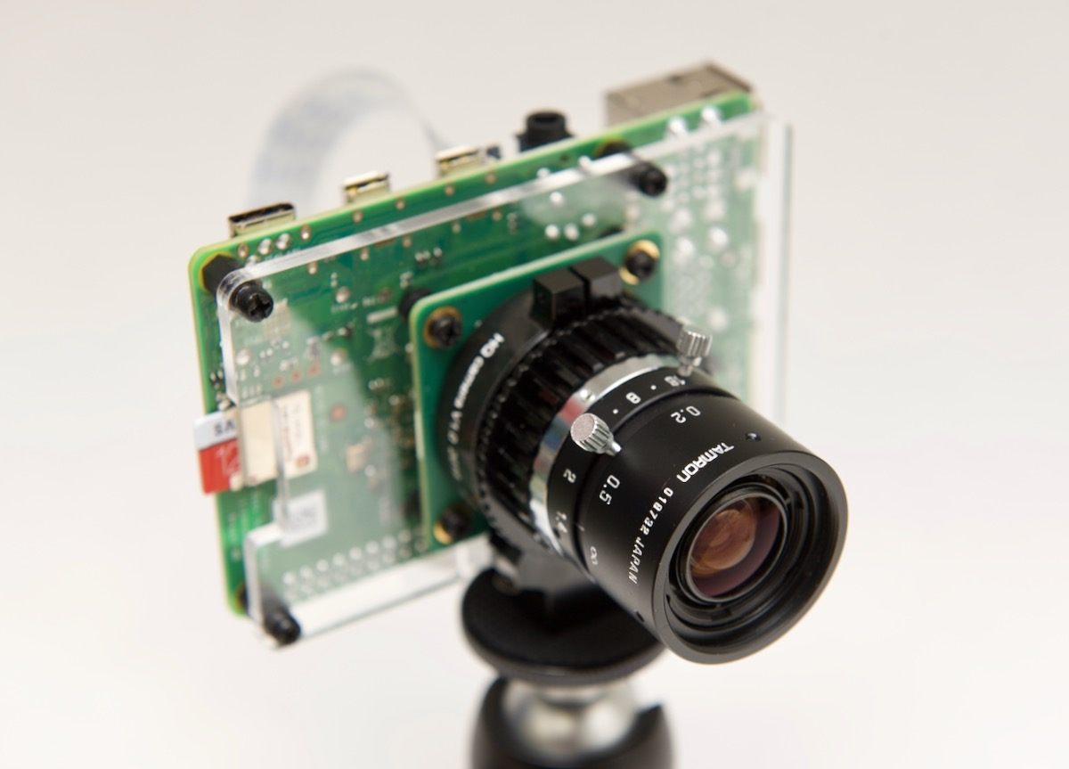
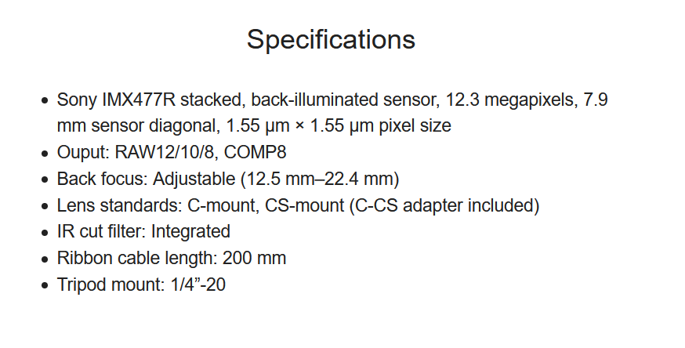
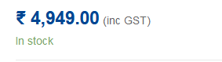
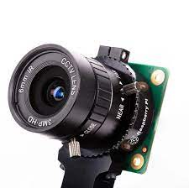
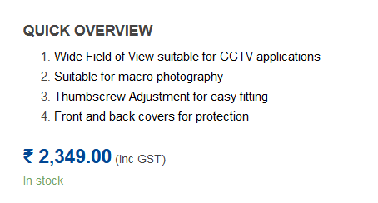
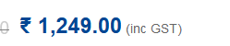
Camera (Raspberry Pi High Quality Camera, 6mm Wide Angle Lens)

Slide 8
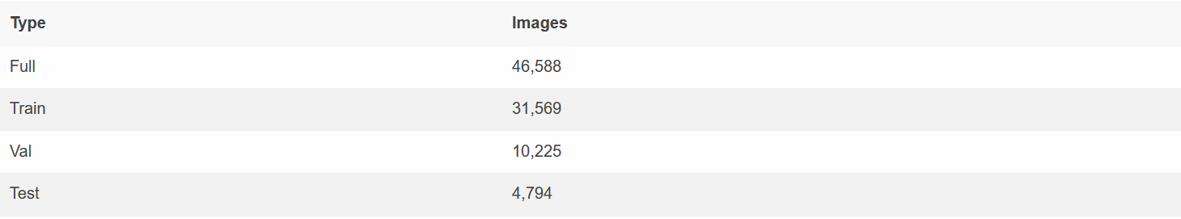
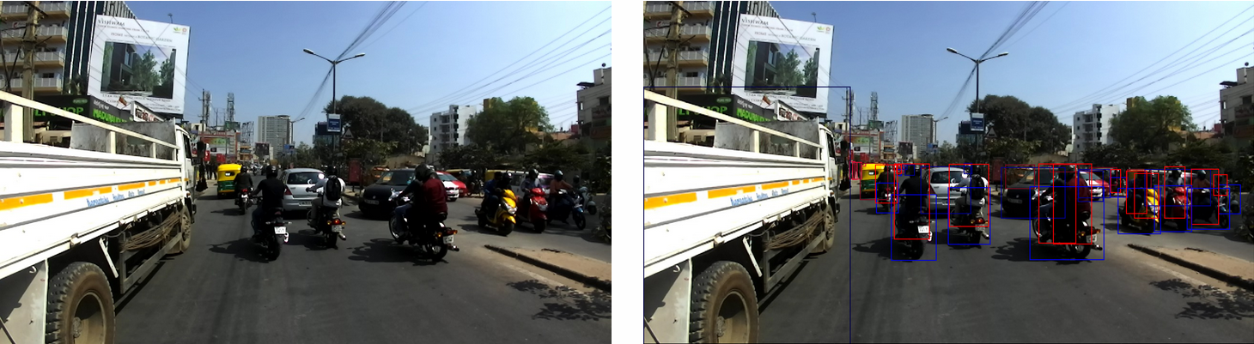
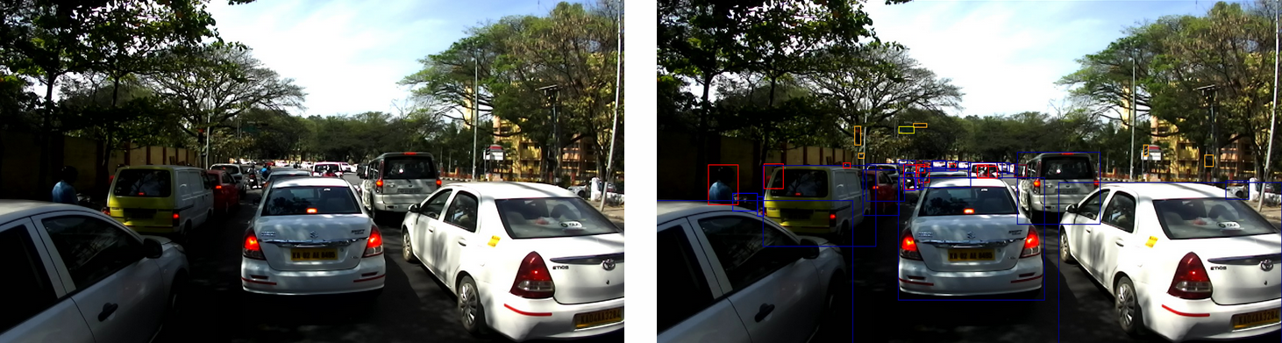
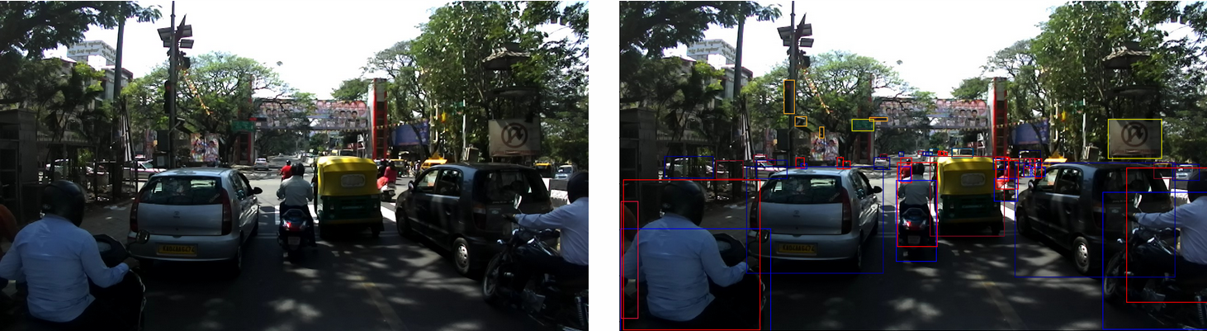
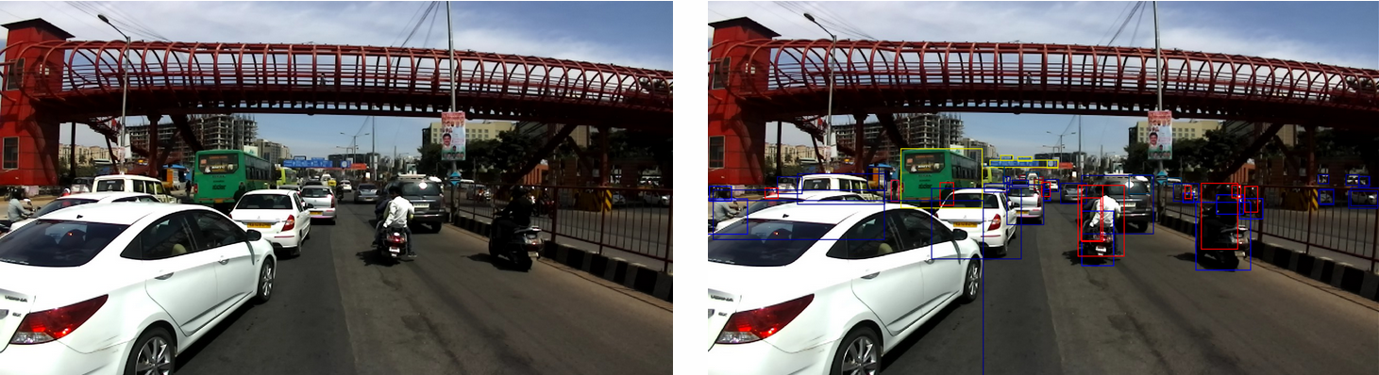
Training Data (Indian Driving Dataset (IDD) consists of more than 40,000 images with bounding box annotations – 22.8 GB)
Sample Images Annotated

Slide 9
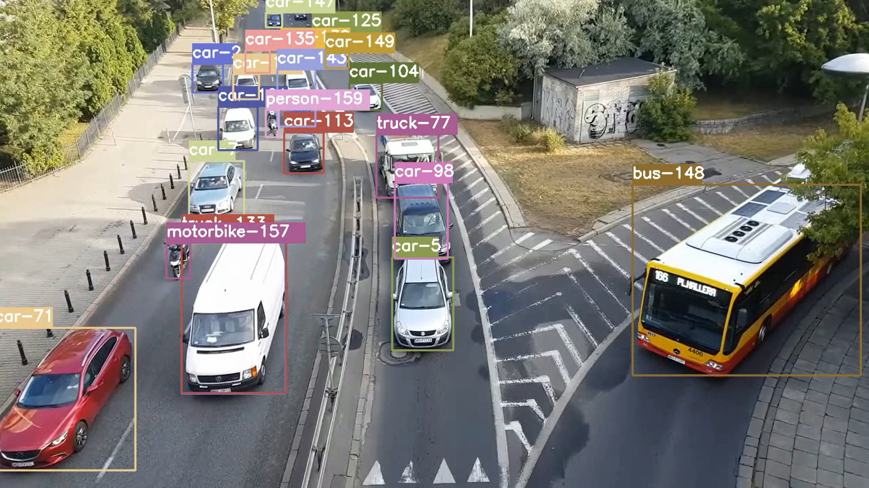
Validation Information

Slide 10
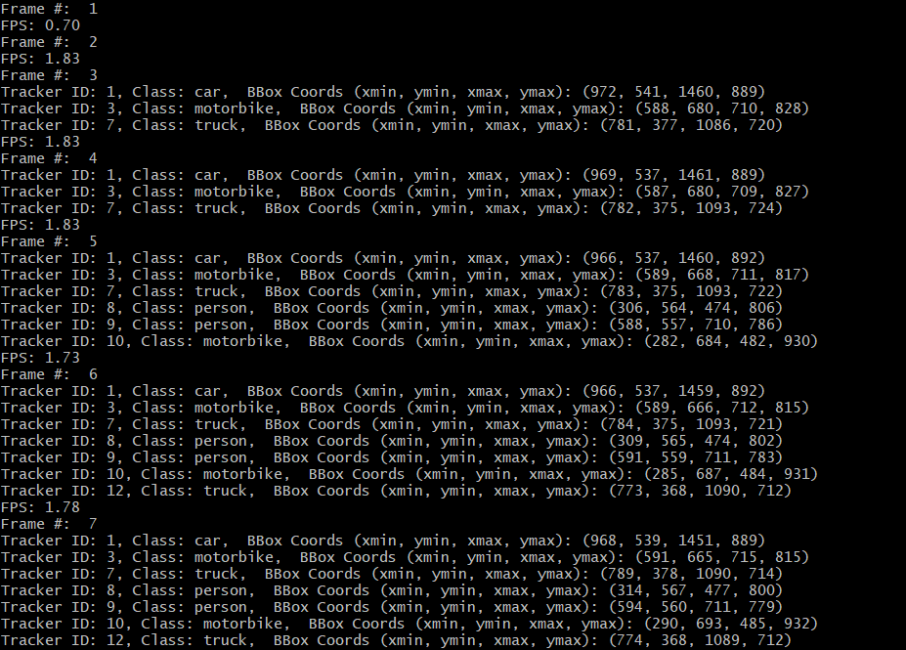
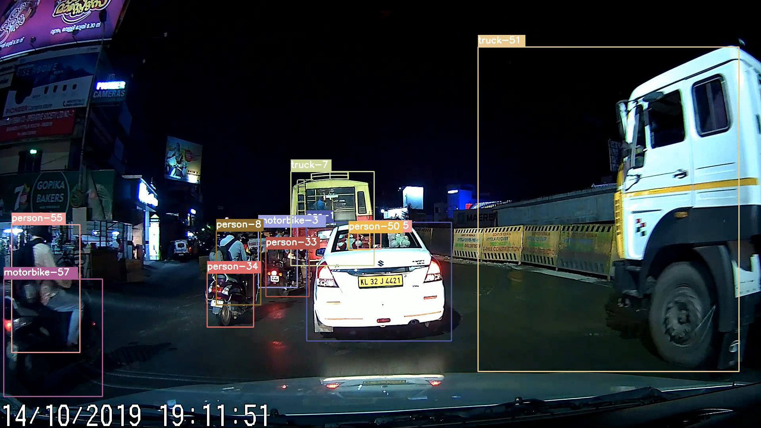
Output
Tested on a Raspberry Pi 4 (8 GB) – Got about 2 FPS running Yolov4 and 15 FPS running YoloV4 Tiny
Raspberry Pi 4 + Google Coral USB Accelerator may give up to 20 FPS on average for Yolov4 (However Coral USB Accelerator is unavailable)
Expecting about 25-30 FPS on Nvidia Jetson TX2/Xavier NX Models
Yolov4 Tiny model offers more FPS at the cost of accuracy.

Slide 11
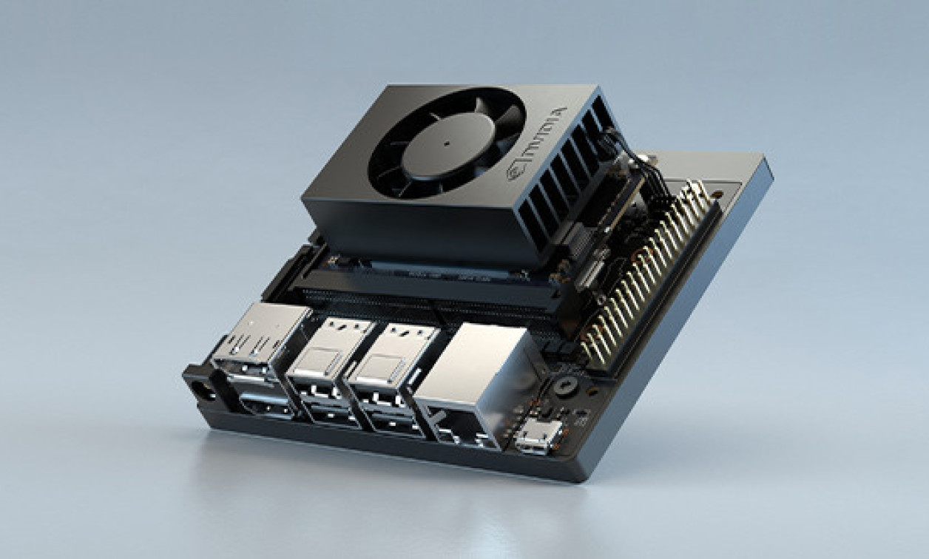
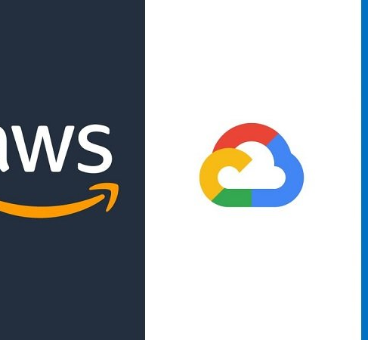
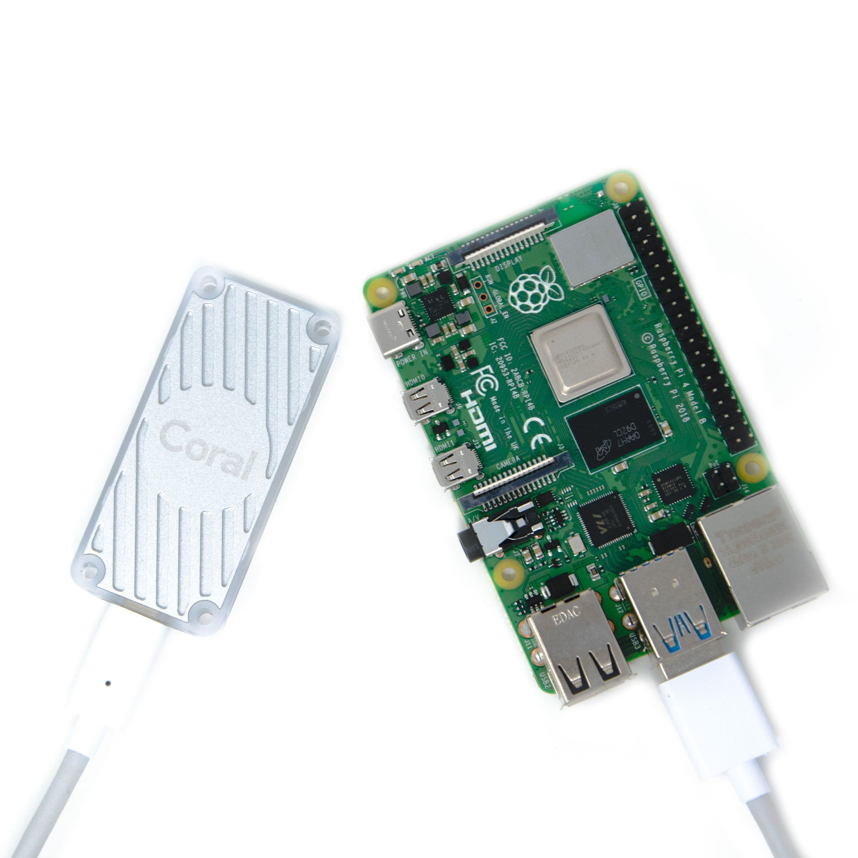
Current Status & Next Steps

Slide 12

Training, Testing and Deploying
Current Status:
Yolov4 and Yolov4 Tiny model (Darknet Framework) pre-trained on COCO Dataset have been tested on Raspberry Pi 4 (8 GB). Got an average of 2 FPS on Yolo & 15 FPS on Yolov4 Tiny.
Have the Indian Driving Dataset on hand for further training (22.8 GB).
Next Steps:
Train & test the model either on Google Cloud Program (GCP) or Amazon Web Services (AWS) – Choice depends on cost.
If available, deploy the model on preferred Nvidia Jetson hardware (TX2i or Xavier NX). Else, deploy on Raspberry Pi 4. (Running on Raspberry Pi 4 in real time is not feasible without a USB accelerator like Intel Movidius NCS2 or Coral USB Accelerator)
Perform suitable optimization techniques like downscaling video resolution to 416x416, GPU inferencing using Tensor RT framework etc.
Integrate the module to the final product. Perform final benchmarks & tests.

